Slide 1

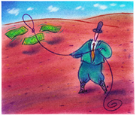
Round-Up the Savings
to Pay for
Facilities Improvements
Reno, Nevada
March 13, 2014
Notes:
What is Energy Savings Performance Contracting (ESPC)?
And, how does it work?

Slide 2
Public Facilities Retrofit Program
Governor’s Office of Energy
Sue Stephens
Energy Program Manager

Slide 3
Public Facilities Retrofit Program
Governor’s Office of Energy
Paul Thomsen
Director

Slide 4
Public Facilities Retrofit Program
Governor’s Office of Energy
Sue Stephens
Energy Program Manager

Slide 5



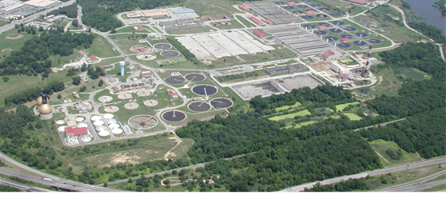
Public Facilities Retrofit Program
Grant from U.S. Department of Energy
To increase energy efficiency through performance contracting
For state and local governments
5

Slide 6
Public Facilities Retrofit Program
For:
State agencies and state higher education institutions
Cities, counties, school districts, other government districts
Education
Information
  Visit our website: www.energy.nv.gov
  Sign up for newsletters and announcements
Workshops
Technical Assistance
Best practices
Model procurement and contracting documents
Guidance to develop a successful project
6
Notes:
The Nevada Governor’s Office of Energy provides education and information as well as technical assistance to help you decide if performance contracting is right for you and to guide you through to success.
Nevada legislation makes performance contracting available to state and local governments through the Nevada Revised Statutes 332 and 333A.

Slide 7

Public Facilities Retrofit Program
Public-Private Partnership
Mission:
Increase awareness and use of performance contracting in Nevada.
Public Sector Participants
Nevada Governor’s Office of Energy
Project managers of successful projects
Others interested in the mission
Private Sector Participants:
ESCOs
Financial Institutions
Vendors of energy efficient equipment
Performance contracting specialists/consultants
Utilities
Nevada Chapter
N
7

Slide 8

We’re here to help you get started
and see you through
Contact us:
    Sue Stephens
    Energy Program Manager
    Public Buildings Retrofit Program
    775-687-1850 Ext. 7325
    sstephens@energy.nv.gov
    www.energy.nv.gov
8

Slide 9
Public Facilities Retrofit Program
Governor’s Office of Energy
Linda Smith
Program Consultant (9Kft Strategies in Energy)

Slide 10
What is Performance Contracting?
…and, how does it work?
Notes:
What is Energy Performance Contracting (EPC)?
And, how does it work?

Slide 11

What Problems Do You Face at Your Facility?
Competing needs for the budget
Maintenance problems or
comfort complaints
Limited expertise on
technologies
Too many demands on
staff time to launch new
projects
Yet…you want to replace equipment and
modernize your facilities
11
Notes:
You might face some of these problems at your facility….
There are always competing needs for the budget
And, maintenance problems and comfort complaints likely keep you from doing better facility management like preventive maintenance
You may have limited expertise on technologies
And, you have too many demands on staff time to launch new projects
Yet, you want to replace equipment and modernize your facilities!

Slide 12

If you face these problems…. you are not alone
An Innovative Solution
Performance Contracting
Energy Savings
Performance
Contracting
…a smart way to get better buildings
12
Notes:
If you face these problems,
you are not alone
An innovative solution to overcome these problems is energy savings performance contracting.
It’s a smart way to get better buildings.

Slide 13
What is Energy Savings Performance Contracting?
Energy Savings Performance Contracting (ESPC)
Projects pay for themselves
Savings stack up over time…
A way to upgrade your facilities without dipping into your capital budget…
Using future cost savings to pay for projects
13
Notes:
Energy savings performance contracting takes advantage of the fact that energy saving projects pay for themselves.
Savings stack up over time and accumulate to the point that they can pay for the entire up-front cost of the project.
It’s a way to upgrade your facilities without dipping into your capital budget, using future cost savings to pay for projects.

Slide 14
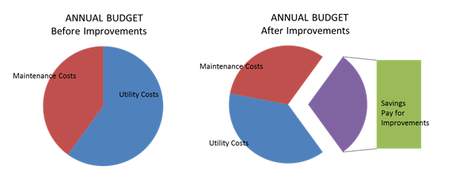
How It Works – Annually
Each year money in your budget is freed-up to pay for equipment!
14
Notes:
The pie on the left shows the annual budget, where a portion of the pie is for
energy costs and another portion is for maintenance costs.
The pie on the right shows what that budget would look like after installing energy-saving equipment. Both utility & maintenance costs are reduced, freeing up a portion of the budget pie to pay for the improvements over time.
So, facility owners can make the building improvements right away without impacting the capital budget, and without competing for budget approval.

Slide 15
How It Works - Financing
Multi-Year Lease-Purchase Agreement
Financed through lease-purchase agreement (municipal tax-exempt)
Annual cost savings exceed annual payments
Typically does not impact debt (common legal perspective)
Financing term is up to 15 years (per legislation)
Blend and leverage funds (savings plus utility rebates, grants, bonds, budgeted funds)
15
Notes:
Projects are financed, then set up as a 15-year (maximum) lease-purchase – a municipal tax-exempt lease-purchase agreement - where the annual savings are guaranteed to make the annual lease-purchase payment.
Under treasurer rulings, it’s often not considered debt because it’s paid through annual budget savings and doesn’t impact the debt ceiling (it’s annually renewable and subject to annual appropriations).
It’s intended to be 100% paid for through resulting savings, but other funding sources could be blended in to further expand the scope of the project and achieve even more savings.

Slide 16
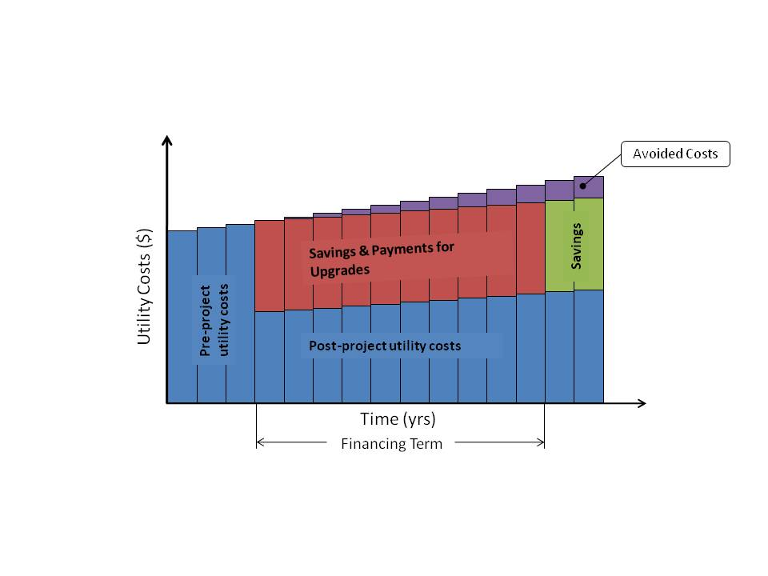
How It Works – Over the Years
The long-term view
16
Notes:
This illustrates the long-term view.
The blue segments show the true utility costs before and after retrofits.
The red segments show the savings that are captured to pay for the projects throughout the financing term.
The green segments show that savings continue to accrue after the projects are paid for and that you get to reap those savings through the remaining life of the equipment.
The purple segments at the top show that as utility costs escalate more than planned, you reap those savings as well.
We often call “savings” “avoided costs” to avoid the misinterpretation that those moneys are available – the bulk of the savings are committed to pay for the projects.

Slide 17

The ESCO Partner
Contract with an
Energy Service Company
(ESCO)
The ESCO brings in
a team of specialists
17
Notes:
The key to making this happen is an energy service company, or ESCO.
The ESCO will bring a team of specialists to tackle every aspect of your project.

Slide 18





The ESCO Partner
A qualified ESCO puts many different pieces
together in a turnkey approach:
Identify and evaluate project opportunities
Help arrange for financing and other funding sources
Design, install, commission and manage projects
Measure and verify savings
Train staff, provide ongoing maintenance services And, guarantee that projected savings will cover all costs
18
Notes:
You contract with your selected ESCO who will put the pieces together in a turnkey approach.
The ESCO will first identify and evaluate project opportunities,
Then help arrange for financing and bring-in other funding sources that may be available
Once the performance contract is signed, the ESCO will design, install, commission, and manage projects.
Another critical piece is that the ESCO will measure and verify savings, applying the measurement and verification plan that was developed before signing the contract.
The ESCO will train staff to ensure savings over the long term. And, the ESCO can provide ongoing maintenance services as negotiated in the contract.
Most importantly, the ESCO will guarantee that savings cover all costs (and pay the difference if they don’t!)
So, the ESCO puts all the pieces together in a turnkey approach.

Slide 19
How ESPC Works
2 Contractual Agreements
Secured by the ESCO Guarantee
Government
Owner
Performance Contract
ESCO
Lease-Purchase
Agreement or other
funding arrangement
ESCO guarantee: Savings => Payment
Financier
19
Notes:
This shows the contractual arrangement. Between the three parties including the financing partner.
The facility owner has a contract with the ESCO and a parallel contract with a financing company. The ESCO typically does not provide financing but will facilitate the financial partnership.
What connects the ESCO and the financial partner is the performance guarantee,
where the ESCO bears the financial risk of the project and guarantees that savings will meet the annual financing payment, making the customer whole to pay the financing company in the event of any shortfall in guaranteed level of savings.

Slide 20

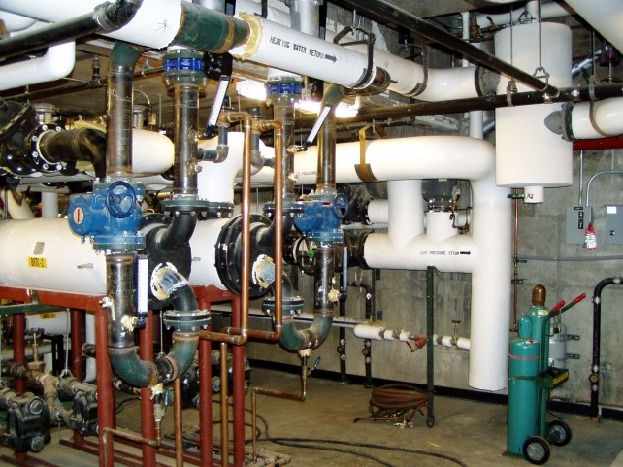

EPC Scope
Measures that save:
A Broad Range of Measures:
Energy
Water
Operational, utility, maintenance costs
And beyond (waste handling and other infrastructure improvements)
Lighting equipment replacements
Building automation system upgrades
HVAC system improvements
Boiler replacements
Plant improvements
Renewable energy systems
Landscape irrigation
Plumbing fixture replacements
Commissioning
Utility rate adjustments
LED traffic and
street lighting systems
20
Notes:
ESPC projects can potentially include anything that saves energy and water costs as well as operational and maintenance costs.
This leads to a broad range of measures such as the ones listed.

Slide 21





5 Steps to Success and Program Services
Decide if performance contracting is right for you
(Assess your needs & potential benefits)
Services: FREE engineering study, Board presentation, meetings
Select an Energy Service Company, ESCO
(Develop an RFP)
Services: FREE RFP development, advisor
ESCO identifies energy-saving opportunities
(Develop an investment grade audit contract)
Services: Audit contract development, negotiating tips, engineering review of audit
ESCO implements projects
(Negotiate an Energy Performance Contract)
Services: Contract development, negotiating tips, engineering & process advisor
Verify savings and enjoy the benefits
(Monitor long-term performance)
Services: Engineering review of results and basic follow-up monitoring
Notes:
These are the steps to implement a successful energy savings performance contract.
We have tools and services to support you in each step.
First, decide if performance contracting is right for you (assess your needs and the potential benefits)
Our program services include….
Once you’ve got the “go” decision, develop an RFP to select an ESCO, using our model RFP and getting support from your procurement department.
Our services for this step are….
You’ll contract with your ESCO to do an investment grade audit.
We have a model audit contract you can customize and have your attorney review. We can then help you….
After reviewing the audit report, you’ll negotiate with the ESCO to develop an energy savings performance contract. This is the “implementation” contract. Make sure it’s thoroughly documented.
Again, we have a model contract for you to develop with your ESCO and attorney. Our services to help you through the performance contract include…..
Finally, after the installation you’ll regularly monitor the results and critically review the M&V reports. Our services at this stage include…

Slide 22

WHY should I consider doing a performance contracting project?
22
Notes:
There are many good reasons to implement an energy savings performance contracting project. It’s important to consider the risks at the onset and develop a plan to manage those risks.

Slide 23
Benefits for all levels of government
Meet Climate Change & Energy Saving Goals
Reduce energy use, long-term
Modernize infrastructure
Better buildings now
Good Environmental Stewardship
Energy & water savings
Pollution prevention
    Renewable energy opportunities
Reduce our dependence on fossil fuels
Wise use of government dollars
Reduce the taxpayer burden
Divert wasted energy dollars to pay for infrastructure
Economic development
Create Jobs – real jobs now! (ESCO staff, Subcontractors to ESCOs,
  Equipment suppliers , engineers, installers, on-site energy managers,
  service providers and more)
Pump money into your local economy
23
Notes:
For government decision-makers there are many appealing reasons to implement energy savings performance contracting projects.
Looking at the big picture from the state and national perspective, wide-spread use of ESPC effects:
Infrastructure modernization on a huge scale.
Long-term reduction in energy use dents our dependence on foreign oil.
Environmental stewardship which now is becoming a driver for EE.
And, benefits our nation’s safety .
And, I’ll add another – economic development – billions of construction projects that would not otherwise happen, creates jobs and keeps utility dollars circulating in the local economy.

Slide 24
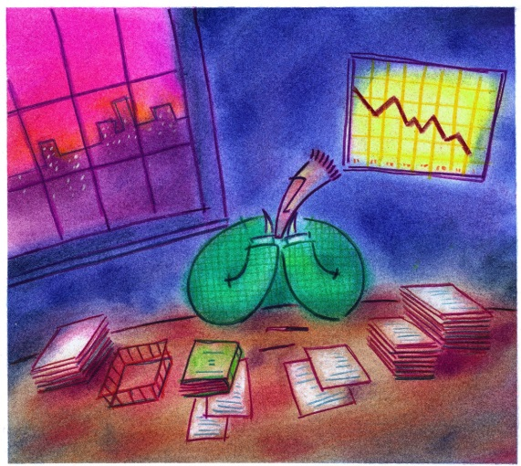
Benefits for the facility manager
Solution to Limited Budgets
Capital improvement without spending capital dollars
Avoid the cost of delay – it costs money to wait!
Leverage other funds
(utility incentives, grants, bonds, in-house funds)
Stabilize budgets – less risk from future energy rate increases
A sustainable approach, post-ARRA
  Better Buildings
Comprehensive, whole-building approach for better systems and deep savings
Improve work/study environment - indoor air quality, comfort and lighting quality
Modern systems
  Sustained Energy Savings
Ongoing project monitoring to verify savings
The ESCO takes on the risk of performance
24
Notes:
There are many reasons a facility manager is interested in performance contracting:
Better buildings, improved comfort, and ability to eliminate a lot of maintenance problems… it’s a great way to upgrade facilities.
A financial solution is what everyone wants, of course.
And, It’s a comprehensive approach to get deep savings – savings of 25% or more - savings which are guaranteed.
It offers expertise – from the onset of developing a project to the finish of construction and beyond.
It includes measurement & verification of savings which confirms the bottom-line benefit.

Slide 25
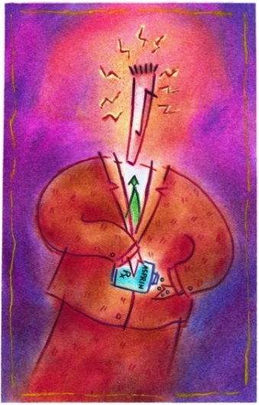
Benefits for the facility manager (more)
Maintenance Problems Solved
Handle deferred maintenance (finally!)
Manageable systems
Trained staff
A Good Process
Time-effective, cost-effective approach for completing facilities energy upgrades
Guarantee of energy savings offloads financial and performance risk
One stop shop = single point of accountability (ESCO)
ESCO selected for best value, not lowest bid
Owner participates in final equipment and subcontractor
selection
Low-interest financing options available
Annual savings verification done per International
Performance Measurement & Verification Protocol (IPMVP)
25
Notes:
There are many reasons for a facility owner to consider performance contracting:
Better buildings, improved comfort, and ability to eliminate a lot of maintenance problems… all resonate with facilities managers wanting to upgrade their facilities.
It’s a financial solution to overcome budget limitations and implement projects now.
And, It’s a comprehensive approach to get deep savings – savings of 25% or more - savings which are guaranteed.
It offers expertise from the onset of developing a project, through construction and beyond.
It includes measurement and verification of savings to ensure guaranteed savings are achieved, providing a way for you to confirm the bottom-line benefit.

Slide 26
We’re here to help you get started
and see you through
Contact us:
    Sue Stephens
    Energy Program Manager
    Public Buildings Retrofit Program
    775-687-1850 Ext. 7325
    sstephens@energy.nv.gov
    www.energy.nv.gov
26

Slide 28

Public Facilities Retrofit Program
Governor’s Office of Energy
Chris Halpin, PE, CEM, CMVP, LEED AP
Program Consultant – Technical Assistance (Celtic Energy)

Slide 29

FREE Technical Assistance to Get Started
Determine if Performance Contracting is right for you
  Assessment of facility opportunities through performance contracting
  On-site meetings and facility walk-throughs
  Benchmarking energy use and costs
  Support for your decision-making team to get the “go” decision
Competitively select an ESCO
  Apply a standardized process
  Help prepare the RFP
  Serve as a neutral advisor
29

Slide 30

Continued Technical Assistance
Your project’s savings will pay for continued technical assistance (as referenced in statute)
Investment Grade Audit
  Provide a 3rd party review of the savings projections and recommended measures
Performance Contract (implementation contract)
  Educate and advise during contract negotiations
  Ensure thorough documentation
  Ensure reasonable project costs, markups, etc.
  Ensure sound measurement and verification
  approaches
30

Slide 31
FREE Technical Assistance
Building the Project Team
Conduct a training seminar for Agency personnel to ensure understanding of ESPC scope, financing, M&V, etc.
Discuss “Lessons Learned” from previous ESPCs
Secure commitment of all stakeholders to ESPC
Liaison with NV Energy Office
31
Notes:
This is usually in there for initial portion of an ESPC but I think this all still applies as an intro to demonstrate that we understand it is important to build rapport among stakeholders

Slide 32
FREE Technical Assistance
Meet with facility management staff, discuss O&M, ECM opportunities
  What projects have been completed?
  Are there critical infrastructure needs?
  Planned projects short of funding?
Review and benchmark existing utility data. Compare facilities to peers using BTU/SF, $/SF
  Create utility baseline
  Helps prioritize targets
Determine if Performance Contracting is right for you
  Assessment of facility opportunities through performance contracting
  On-site meetings and facility walk-throughs
  Benchmarking energy use and costs
  Support for your decision-making team to get the “go” decision
32

Slide 33
FREE Technical Assistance
Follow standardized RFQ/RFP process established by the energy office through this DOE grant
Help prepare the RFP
  Use the energy office template, modify as needed
  Assist with Technical Facility Profile
    Building descriptions, utility data, plans
  Serve as a neutral advisor
  Discuss assembly of selection committee
  Brief committee on RFP issuance, proposal review and scoring criteria, ESCO selection process,etc.
  Assist with “Board” presentations
Competitively select an ESCO
  Apply a standardized process
  Help prepare the RFP
  Serve as a neutral advisor
33

Slide 34
Public Facilities Retrofit Program
Governor’s Office of Energy
Sue Stephens
Energy Program Manager

